Slide 1
Java Microservices with Spring Cloud: Developing Services
Introduction to Microservices, Spring Boot and Spring Cloud

Slide 2

Overview
Why are microservices architectures popular?
The core characteristics of microservices About Spring Cloud and Spring Boot Goals and prerequisites for the course

Slide 3
“Loosely coupled service oriented architecture with bounded context.”
Adrian Cockcroft, VP at Amazon

Slide 4

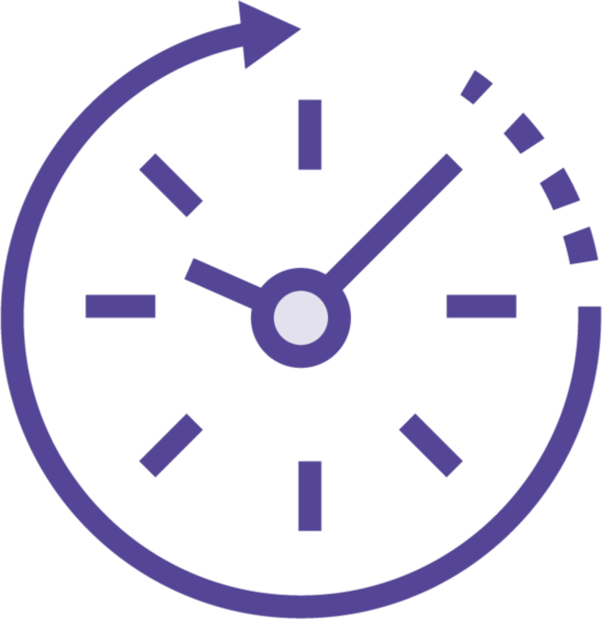
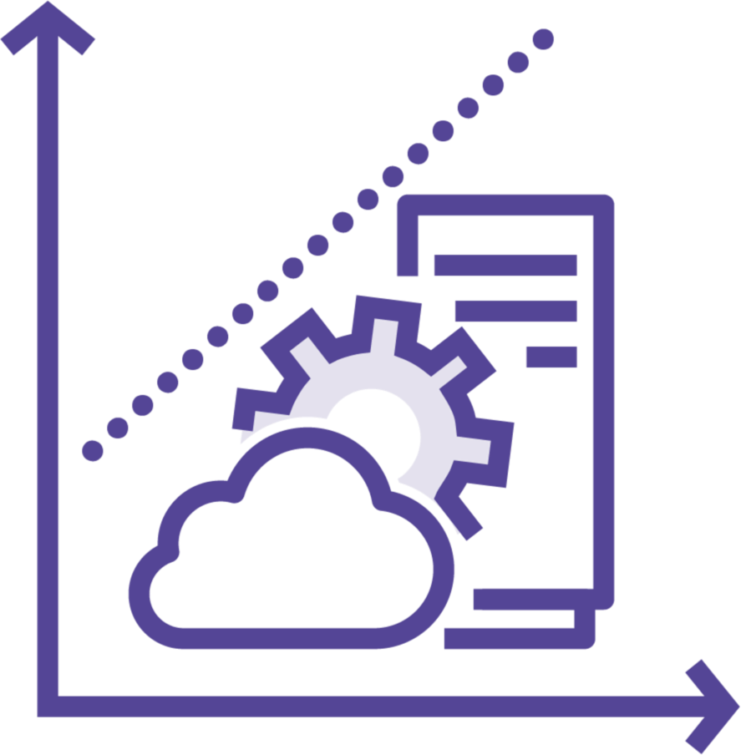

Why are Microservices Architectures Popular?
Desire for faster changes
Need for greater availability
Looking for fine- grained scaling
Compatible with a DevOps mindset

Slide 5
Core Characteristics of Microservices
Components exposed as services
Tied to a specific domain
Loosely coupled
Built to tolerate failure
Delivered continuously via automation
Built and run by independent teams

Slide 6
Questions About a Microservices Architecture
How am I supposed to ship changes continuously?
Should every app be turned into a set of microservices?
How do I find my service if the URI can change?
What if my team isn’t arranged for DevOps?
How do services maintain consistent configuration at scale?
Is there a single stack for microservices?
What’s the right way to secure services?
How do I troubleshoot problems?
How do I keep a poor- performing service from taking everything down?
Isn’t a monolithic app
just simpler?

Slide 7

Microservices Scaffolding with Spring Cloud
Released March 2015
Implement common distributed system patterns
Includes industry-standard technologies Fully open source software
Optimized for Spring Boot applications Run it anywhere

Slide 8
Catalog of Spring Cloud Projects
Spring Cloud Config | External configuration management
Spring Cloud Netflix | Implementation of Netflix OSS components
Spring Cloud Consul | Service discovery and management with Consul
Spring Cloud Security | OAuth2 enablement for microservices
Spring Cloud Sleuth | Distributed tracing for Spring applications
Spring Cloud Function | Implement logic as (serverless) functions
Spring Cloud Stream | Event-driven framework for sending/receiving messages
Spring Cloud Data Flow | Orchestration of data microservices
Spring Cloud Zookeeper | Service discovery and management with Zookeeper
Spring Cloud Gateway | Programmable router for microservices
Spring Cloud Contract | Test using a consumer-driven contract approach
Spring Cloud Alibaba | AWS | Azure | GCP | Connect Spring Cloud components to public cloud managed services

Slide 9
Catalog of Spring Cloud Projects
Spring Cloud Config | External configuration management
Spring Cloud Netflix | Implementation of Netflix OSS components
Spring Cloud Consul | Service discovery and management with Consul
Spring Cloud Security | OAuth2 enablement for microservices
Spring Cloud Sleuth | Distributed tracing for Spring applications
Spring Cloud Function | Implement logic as (serverless) functions
Spring Cloud Stream | Event-driven framework for sending/receiving messages
Spring Cloud Data Flow | Orchestration of data microservices
Spring Cloud Zookeeper | Service discovery and management with Zookeeper
Spring Cloud Gateway | Programmable router for microservices
Spring Cloud Contract | Test using a consumer-driven contract approach
Spring Cloud Alibaba | AWS | Azure | GCP | Connect Spring Cloud components to public cloud managed services

Slide 10

What is Spring Boot?
Offers an opinionated runtime for Spring
Convention, not configuration Default “opinions” can be overridden Handles boilerplate setup
Simple dependency management Embeds app server in executable JAR Built-in endpoints for health metrics

Slide 11
Reviewing the Spring Initializr site
Looking at Visual Studio Code for Spring development
Creating a new Spring Boot project Editing the properties file
Adding a REST endpoint
Starting and running an application Viewing the Actuator endpoints
Demo

Slide 12
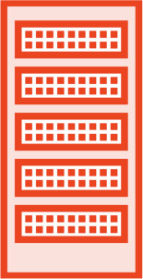
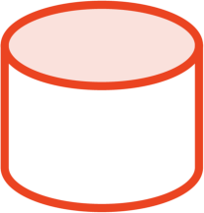
App for the Course – Toll Station System
Toll Station System
Internal Web Application
Toll Rate Service
Toll Process Job
Toll Usage Service
Driver Profile Service
Git repo
Config Server
Function Host
AuthZ Server
Zipkin Server

Slide 13
Goals for This Course
Understand modern microservices patterns
Explore how to build systems that depend on Spring Cloud
Get comfortable using Spring Boot and Spring Cloud
Learn how to configure and extend Spring Cloud

Slide 14

Course Prerequisites
Basic knowledge of Java and object-oriented programming
Familiarity with the Spring Framework Access to a Java-friendly IDE for coding Access to Docker

Slide 15
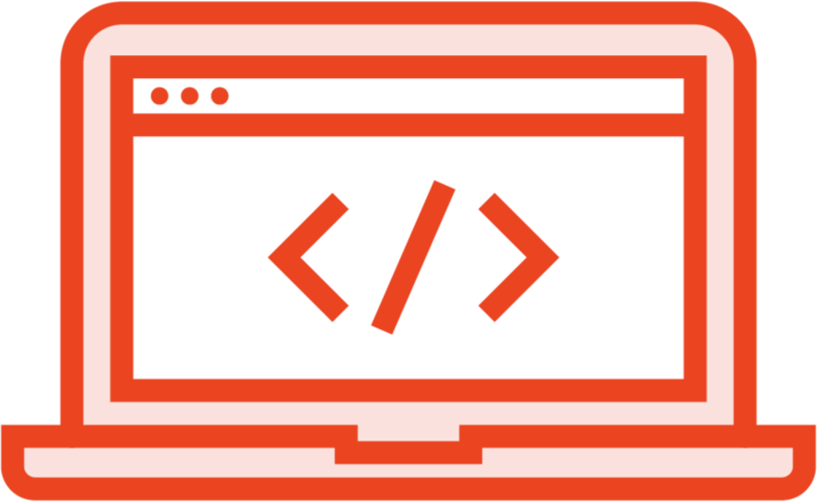
Workstation Setup for Learners
Visual Studio Code with Java/Spring
extensions
Maven build manager Postman for API testing
Docker for running containerized apps
GitHub account

Slide 16
Summary
Why are microservices architectures popular?
The core characteristics of microservices About Spring Cloud and Spring Boot Goals and prerequisites for the course

